Slide 1
Vanessa Davies
Uned Horizon 2020
Swyddfa Cyllid Ewropeaidd Cymru
Horizon 2020 Unit
Welsh European Funding Office

Slide 2
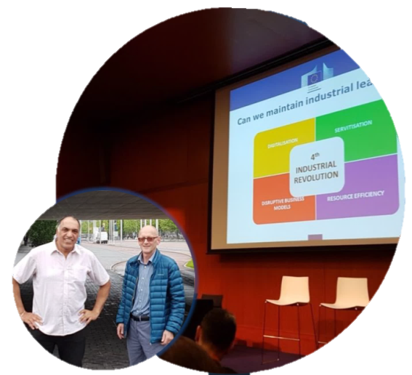
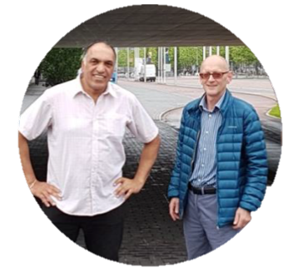
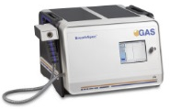
SCoRE CYMRU
Grants to support Welsh-based organisations with:
SCoRE Cymru Support for travel: The Industrial Technologies 2016 – Creating a smart Europe event in Amsterdam.
Travel:
Support for the costs of meeting potential or existing partners and attending key events. The amount of funding will vary:
Maximum of £1,000 per trip;
For SMEs up to 100% of costs, Higher Education up to 50% (or 75% if travelling with a Welsh SME), other organisations (e.g. public sector, large enterprises) up to 50% in certain circumstances.
Proposal development:
support for the costs of relevant sub-contracted expertise, e.g. bid writing, specific legal/technical advice or impact/market research. The amount of funding will vary:
Generally up to £5,000 and 50% of the costs;
Up to £10,000 and 75% of costs available in some cases, e.g. first application, bid co-ordinators.
SCoRE Cymru backed IMSPEX’s application for Horizon 2020 funds which went on to secure €1.5m to lead a European project to revolutionise the way respiratory illnesses are diagnosed.

Slide 3
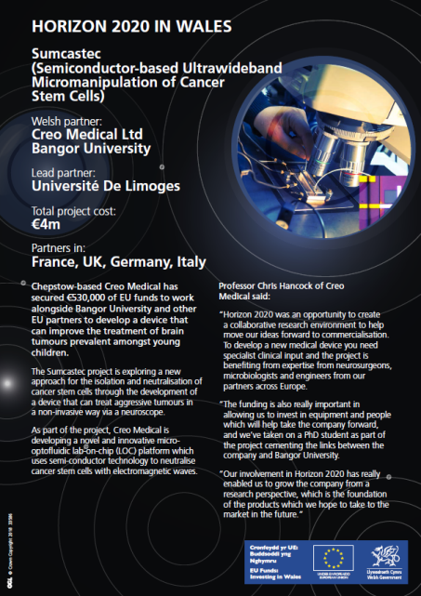
Worth doing?
The Public Health Wales National Health Service Trust participation in the Horizon 2020 EuroCatLink project.
Cardiff and Vale University Health Board participation in the Talk project which focuses on innovation transfer for health service.

Slide 4
https://www.youtube.com/watch?v=9bAVMNpQc-c&feature=youtu.be
Diolch
Dysgwch fwy: / Find out more:
E-bostiwch / Email: horizon2020@gov.wales
Ffoniwch / Call: 0845 010 3355
Ewch i: / Visit:
http://gov.wales/funding/eu-funds/horizon2020

