Slide 1
Gareth Davies
Life Sciences Hub Wales

Slide 2
Purpose
Building upon the integrated capabilities of the Life Sciences Hub Wales, Cardiff University, Swansea University and the University of Wales Trinity Saint David, ACCELERATE will orchestrate and develop a sustainable pipeline of innovation across the (Life Sciences & Health) sector.

Slide 3
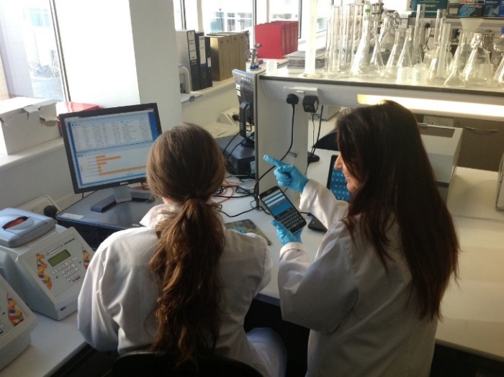
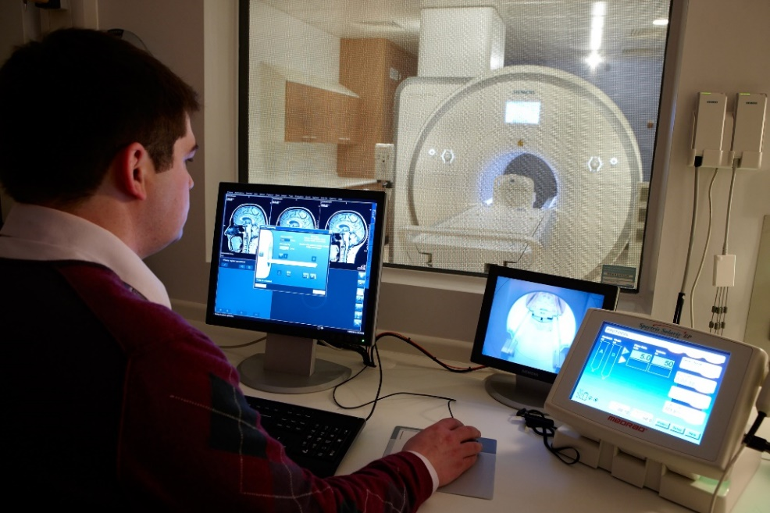
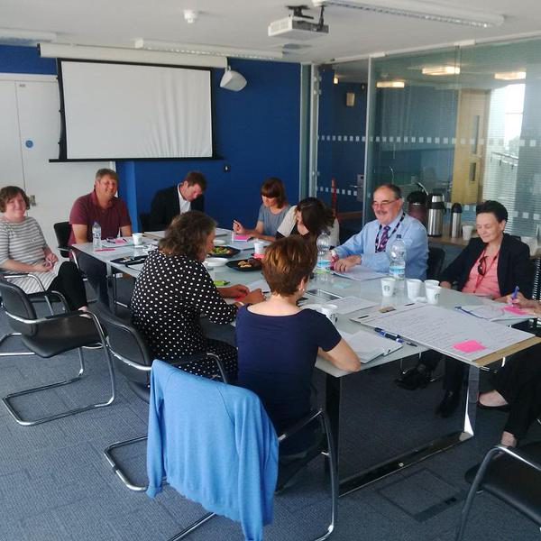
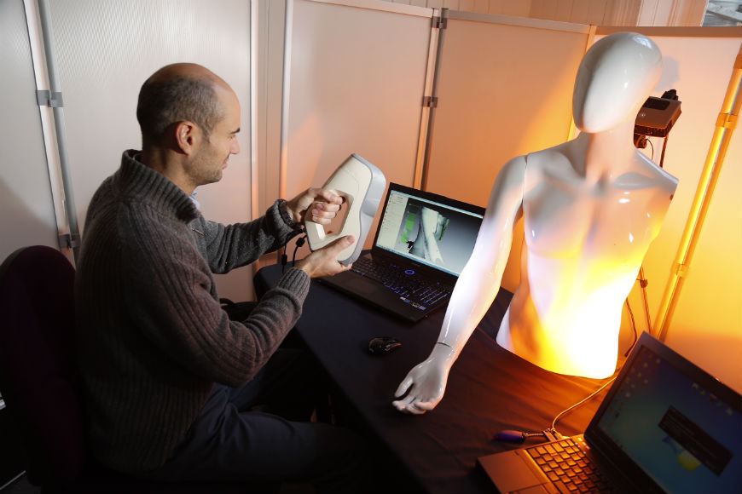
A Co-Production Partnership

Slide 4
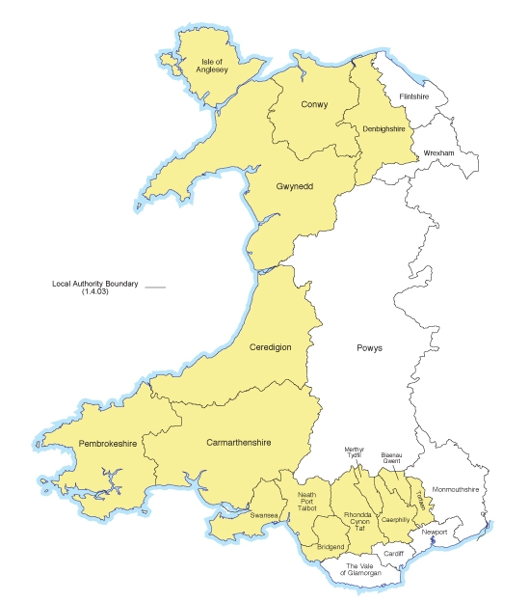
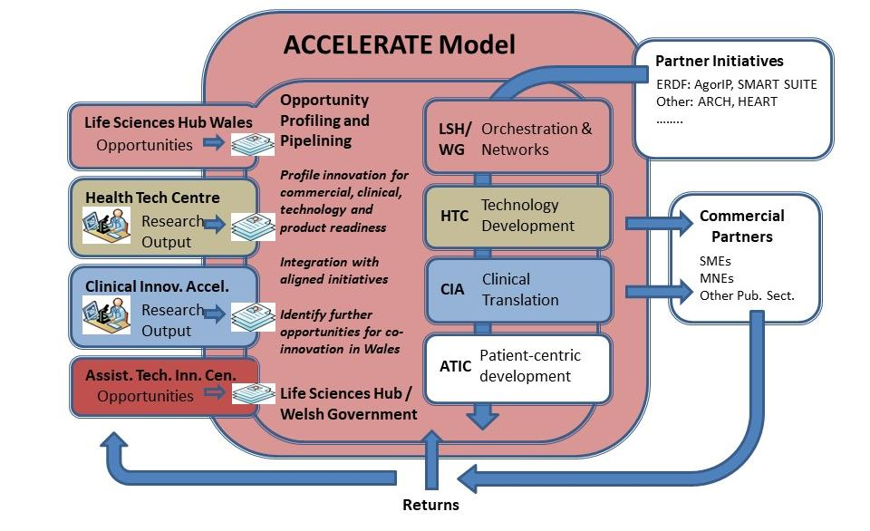
A Co-Production Process

Slide 5
ACCELERATE: An Invitation and Request
Engage in the mobilisation (detailed development)
Think of Accelerate as only part of a wider system
Co-produce with Accelerate support Health and Life Sciences Innovation
Starting with;

Slide 6
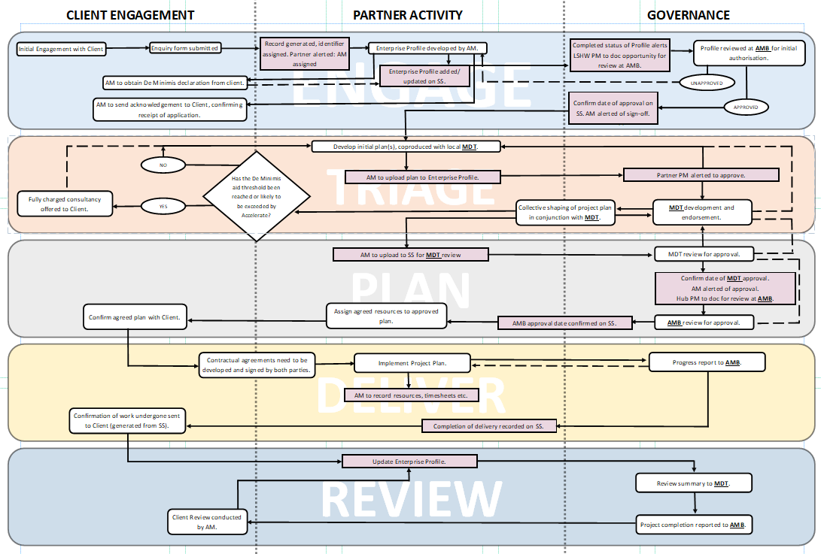

Slide 7
Thank You / Diolch
Web: lshubwales.com/accelerate
Email: Accelerate@lshubwales.com
Twitter: @lshubwales

