Slide 1
Connected Health and IoT: Two real life use cases of APIs in healthcare
Pearce Mutendera,
HSGBU Principal Sales Consultant, EMEA, Oracle

Slide 2
Oracle Healthcare Foundation 7.2
Connected Health and IoT: Two real life use cases of APIs in healthcare
Pearce Mutendera
Principal Sales Consultant
Health Sciences Global Business Unit
March 13, 2018
2018
Notes:
Oct 2017
Update name/title/date

Slide 3
2018

Slide 4
Use Case 1: Connected Health
“The problem with interoperability is not exclusively a technical one – but a cultural problem too”
Notes:
https://www.healthcareitnews.com/news/why-ehr-data-interoperability-such-mess-3-charts

Slide 5
Healthcare Landscape
Fragmentation – Identity, Data, Processes
Emr 2
Patient engagement
Data warehouse
claims
app
app
hie
Lab systems
app
app
operational
app
Medical devices
app
Ancillary systems
app
app
app
registries
biobank
Emr 1
app
Post acute
facilities
app
2018
Notes:
How did we get to this Fragmentation?
Healthcare systems were not born digital
Digital adoption was organic
Interoperability was technically difficult
There is a never ending expansion of data systems and data types that are produced from patients and their healthcare
Gone are the days of merely increasing human resources to map another point to point and deciding how many different intersections

Slide 6
Healthcare Landscape
Beyond the Data
Emr 2
Patient engagement
Data warehouse
claims
app
app
hie
Lab systems
app
app
How do you aggregate data to
create a single source of truth ?
How do you create a complete longitudinal patient view ?
How do you extract value from the data residing in your multiple systems ?
How do you achieve data governance across the organization?
operational
app
Medical devices
app
Ancillary systems
app
app
app
registries
biobank
Emr 1
app
Post acute
facilities
app
2018
Notes:
It takes way too much effort and time to collate and organize data in a way that allows us to answer the really big questions

Slide 7
Critical Issue – Fragmentation How do we resolve it?
Technology
Multiple standards
Slow maturation
Culture
Government
Vendors (Platform & EHR)
Customers (Health Systems, Patients)
Notes:
2 aspects need to be addressed in order to succeed. Technology & culture

Slide 8
Use Case 1: Connected Health
Maturing Landscape
Notes:
This slide can also be used as a Q and A slide

Slide 9
Technology
New Clinical Integration Landscape - Healthcare Integration World is Changing
 | Then and Now | Now and Future | Reason
Message Standard | HL7 V2 | XML & JSON FHIR, HL7 V3, CDA, CCD | EMR certification
Architecture | Hub and Spoke, Message Centric | RESTful, SOA, Transaction Centric | Evolve vs. Design
Transaction Behavior | Reliable Fire and Forget | Query/Response | Application needs
Communications | MLLP and TCP/IP | Secure Web Services, REST APIs | Latest standards
Message Content Standard & Adherence | None | IHE, HITSP, ONC, FHIR | Semantic interoperability
Standards | Healthcare Specific | Cross Industry | Use what is proven
Purpose/Needs | Intra Organization | Intra and Inter Org, Exposure to Apps | Business needs
Security | Mostly Overlooked | SSL/TLS/HTTPS | Latest standards
Notes:
Why do we need to modernize and change now:
New Standards are different
XML Based
Web Services
Cross Industry
New Standards are mandated
Semantic and Syntactic Interoperability
HIE and Exchange
EMR Implementations
New Data Sharing Requirements
Request/Query for data requires workflow
Greater sharing of data Intra and Inter Organization

Slide 10
FHIR will not solve all interoperaibility problems
New Clinical Integration Landscape
Notes:
Courtesy of Lloyd Price at Zesty Healthcare Digital.
Please note this is Zesty’s view not to be mistaken with Gartner
FHIR – probably no other technology in healthcare interoperability has had so much buy in, hype and expectation since HL7 v2.
But there are problems with it too, which hopefully will be resolved.
Slow maturation of standards – what standard do you develop on?
FHIR extensions could be misused – need for agreed profiles

Slide 11
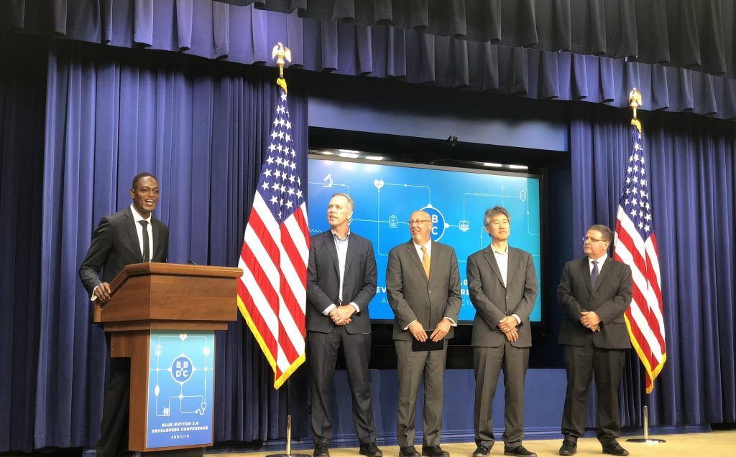
Changing Culture - Vendor Commitment Platform Vendors
Notes:
This is a well intentioned

Slide 12
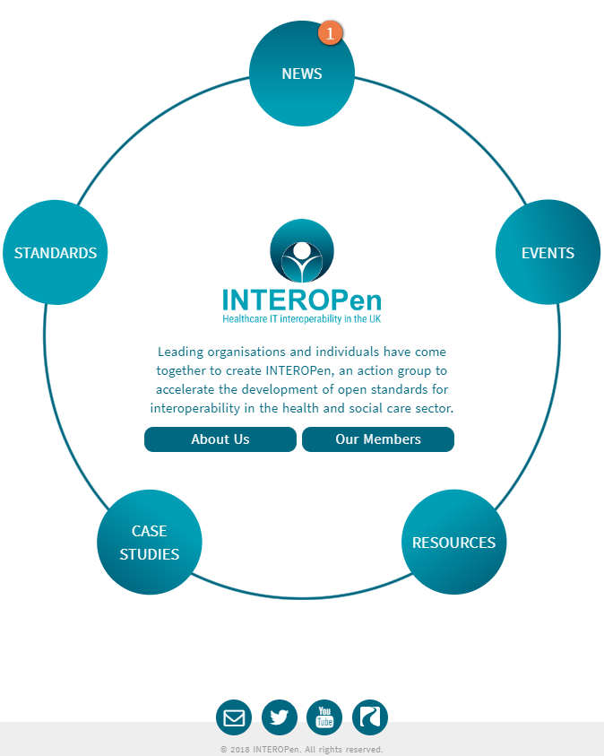
Changing Culture – Government Commitment InterOpen Profiles
Profiles for Connectivity
Standards
Guidelines
Community - Events

Slide 13
Use Case 1: Connected Health
Australia My Health Record
Notes:
This slide can also be used as a Q and A slide

Slide 14
My Health Record Australian Digital Health Agency
Notes:
The national Personally Controlled PCEHR System aims to place the individual at the centre of their own healthcare by enabling access to important health information when and where it is needed by individuals and their healthcare providers
Individuals will be able to choose whether or not to have a PCEHR, and if they choose to participate, they will be able to set their own access controls. With the individual’s permission, key pieces of health information may be viewed by participating healthcare providers across different locations and healthcare settings
Animation outlining the PCEHR System: http://www.youtube.com/watch?v=3IOoUMwSGMI

Slide 15
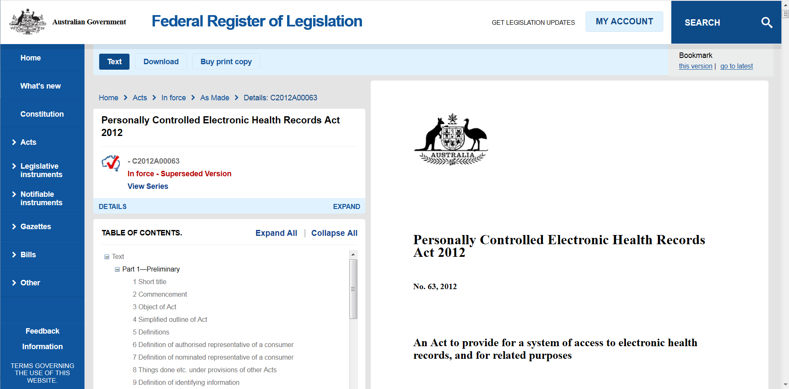
Government Intervention – Enabling Legislation - 2011
https://www.legislation.gov.au/Details/C2012A00063

Slide 16
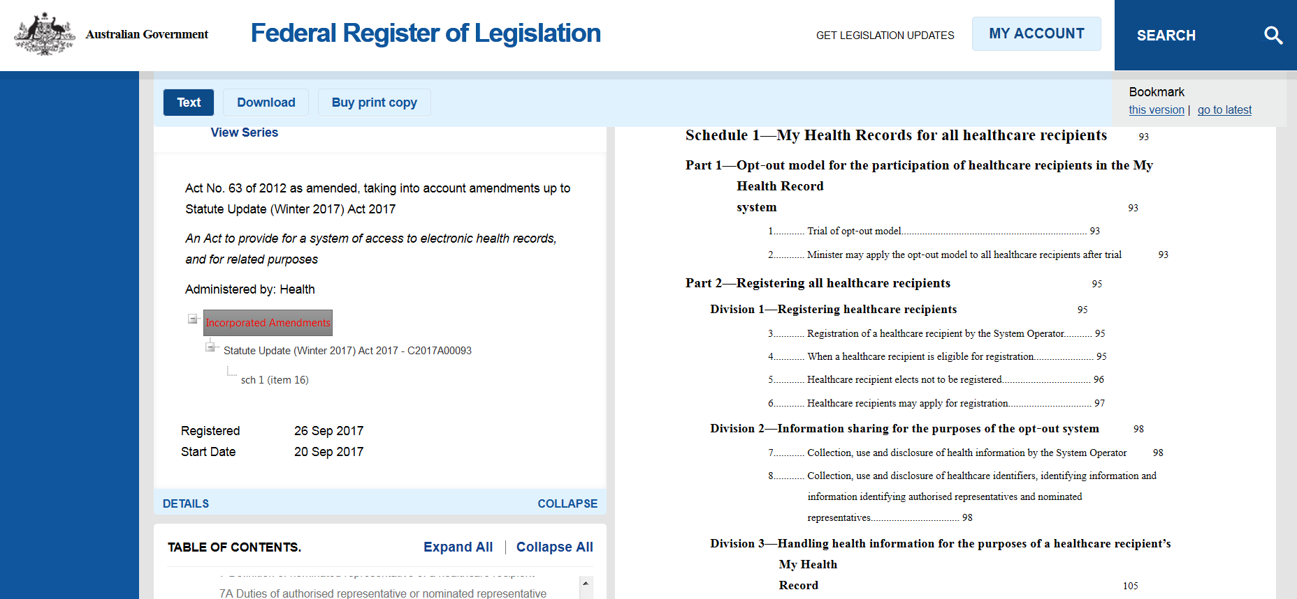
Government Intervention – Enabling Legislation – 2017 – Opt-Out
https://www.legislation.gov.au/Details/C2017C00313
Notes:
21% (5.1 million) of population registered by 2017
Formal opt-out period ended 31/01/2019
<5% opt-out rate

Slide 17
Technical Challenges for a Connected Health Platform
How to identify the patient uniquely and unambiguously?
How to identify the provider uniquely and unambiguously?
How to leverage many messaging (HL7 v2, CDA, etc) standards and combine in a summary view?
How to deal with many terminology (ICD9, ICD10, SNOMED) standards and combine in a summary view?
How to create a unified longitudinal patient record?
How to ensure security, privacy and allow for rigorous consent management?
How to leverage existing clinical data without copying them centrally?
How to scale to cope with regional and longitudinal volumes?
How to reuse EHR data for secondary uses?

Slide 18
Vendor Commitment - Healthcare Interoperability Blueprint
Exemplar eHealth Applications
Infrastructure
Clinical Portal
Patient Portal
Personal Health Apps
Population Health
Personalized Medicine
Translational Research
E-Prescribing, E-Referral, etc.
Home Care Disease Mgmt.
Patient/Citizen Rel. Mgmt.
Application Development, Unified Access Channel, Clinical/Provider/Patient Portals, Mobile Access
Health Services Layer
Orchestration, BPM, API Management
Management & Monitoring
Master Patient & Provider Index
Registry &
Record Locator
Catalog & Terminology Handling
Clinical Data Repository
Multimedia Medical Archive
Security & Privacy
Data Warehouse, Data Lake
Connectivity
Event Streaming and Processing
Extract, Transform, and Load
Operational/Departmental Applications
ADT/PAS
Systems
EMR & Clinical Systems
RIS/PACS Systems
ERP & Billing Systems
Medical & other Devices
DNA Seq. & other Omics
Research
Other Data Sources

Slide 19
HIE/IHE Capabilities Supported by APIs
HIE Specific Functionality
Support for Federated, Centralized or Hybrid models
Extensive Support for Global HIT Interoperability Standards (HL7, IHE, etc.)
Enterprise Master Person Index
Document Registry
Document Repository
Clinical Data Repository
Access Consent Policy Engine
Access Audit Repository
Integration Engine
Terminology Normalization
IHE Profiles Supported
Patient Identifier Cross Referencing (PIX) HL7 v2.x, v3
Patient Demographics Query (PDQ) HL7 v2.x, v3
Multi-Patient Queries (MPQ)
Patient Admission Management – Patient Identity Management (PAM/PIM)
Cross-Enterprise Document Sharing (XDS.b)
Cross-Enterprise Document Sharing for Imaging (XDS-I.b)
Cross Community Access (XCA) and Cross Community Patient Discovery (XCPD)
Audit Trail and Node Authentication (ATNA)
Consistent Time (CT)
http://www.oracle.com/us/products/applications/healthcare/integrating-healthcare-enterprise/overview/index.html

Slide 20
Supported HIE Models
Federated
EHR Index/ Record Locator Service/ Registry
Repository 1
Repository m
Repository 2
...
Repository n

Slide 21
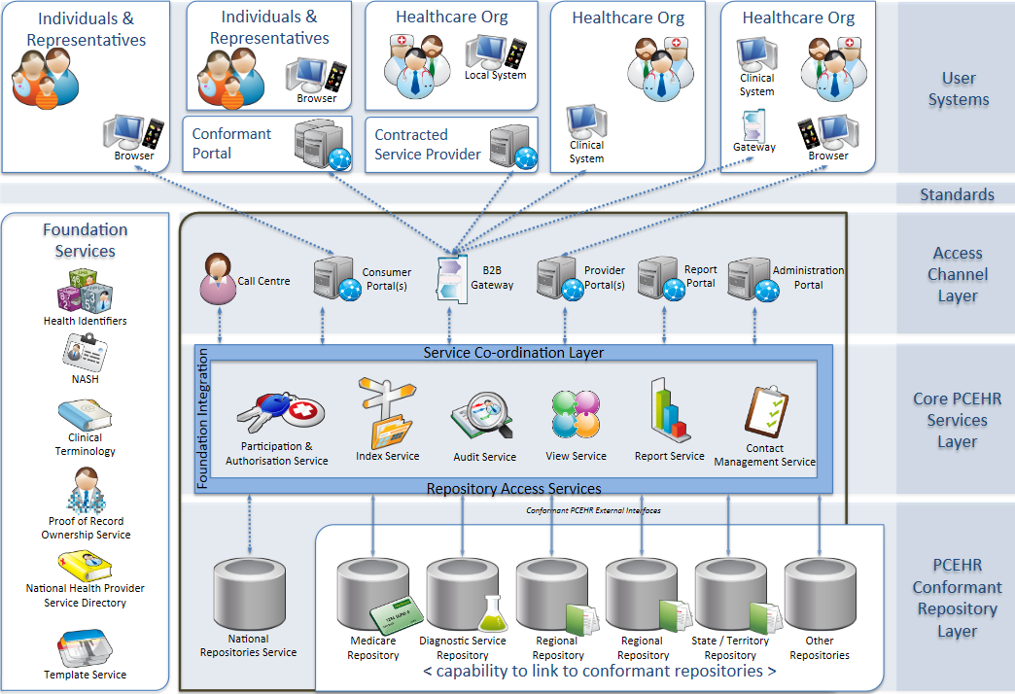
The PCEHR system in 2011
Notes:
The customer wanted to go for a federated HIE model

Slide 22
The PCEHR system 2019
CRMOD
WC+
Custom
OAG
Accenture
OBI
Medicare
IHI
Medicare
NASH
ESB
IDM
HIM
Custom
Custom ESB logic
OBI
NEHTA NCT
?
Medicare IHI
HDR
WC
Notes:
OAG – Oracle API Gateway
IDM – Identity Manager

Slide 23
Conclusion
“The problem with interoperability is not exclusively a technical one – but a cultural problem too”
Culture
Strong government direction and intervention
Patient involvement
Mature technology blueprint
Open standards
APIs

Slide 24
Use Case 2: Internet of Things Integration Health
Notes:
This slide can also be used as a Q and A slide

