Slide 1
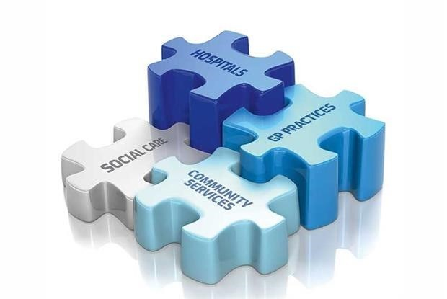
How integrating data in real-time improves pathways of care
Transforming
Transforming
systems
systems

Slide 2
What We Do
A data sharing company
Offering totally interoperable data sharing solutions
Using real-time data
Combining technology with expert operational knowledge
Highly visual Web and App UIs sit alongside real-time data
Went to market in October 2015
Now across 40 different health economies across the UK
40 WTEs (30 data scientists)

Slide 3
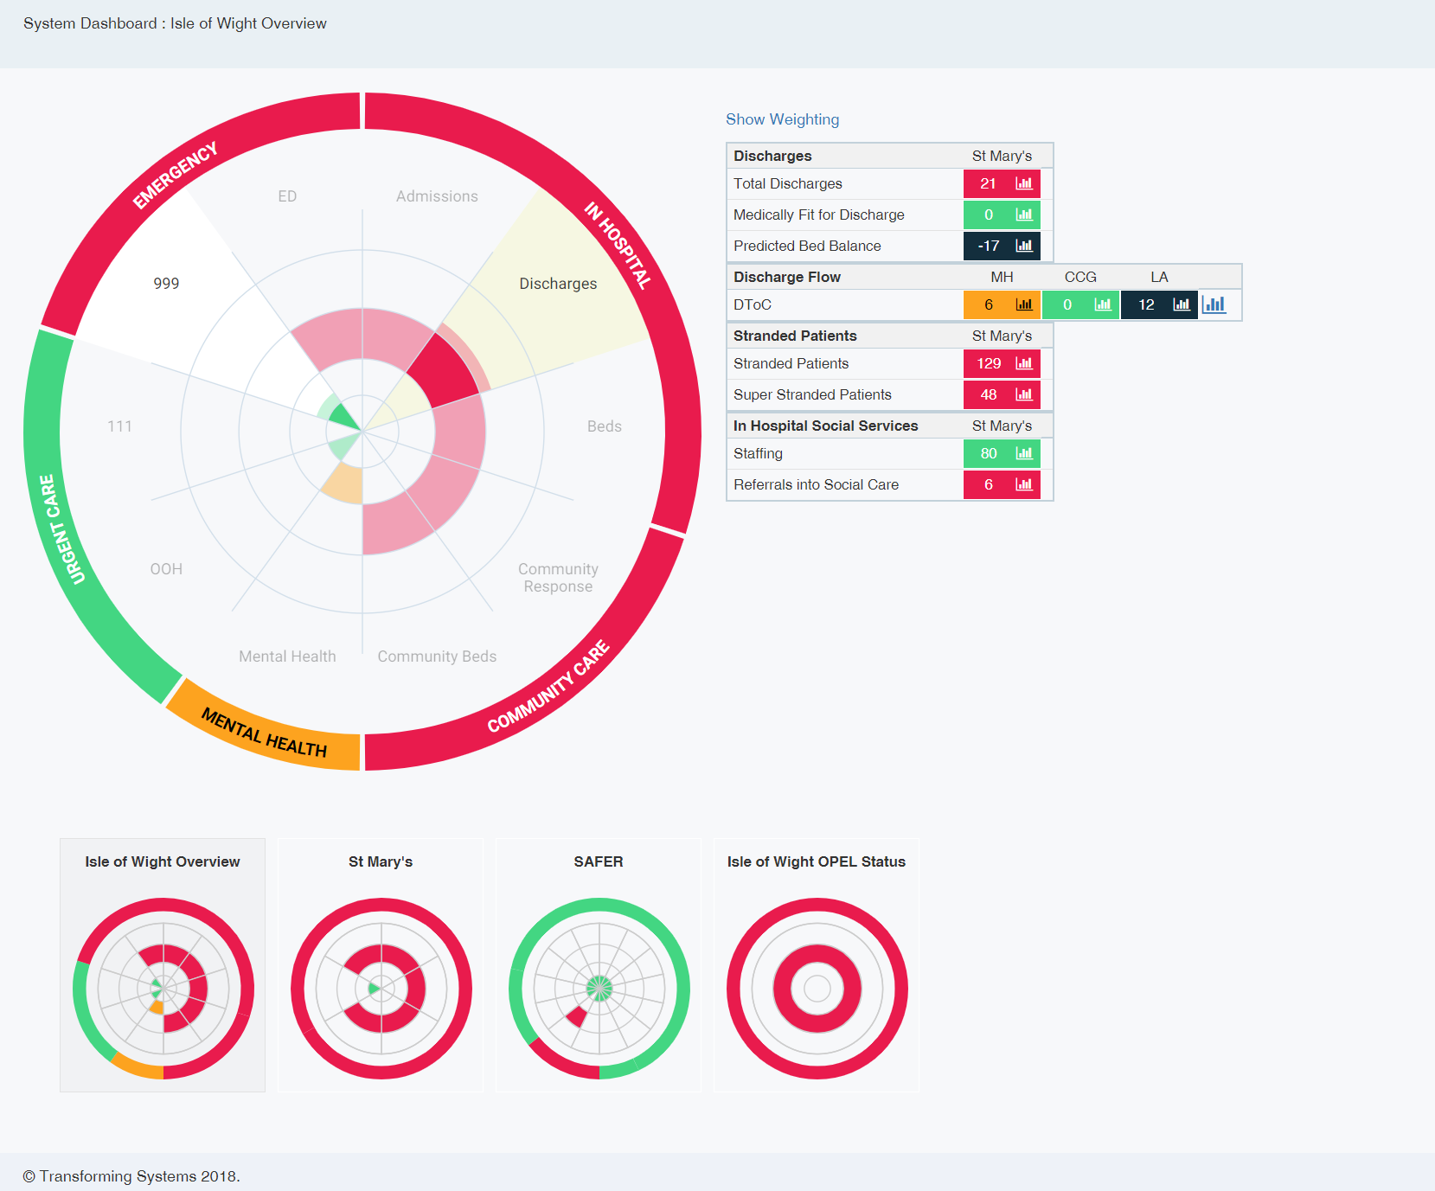
SHREWD: A real-time Operational tool for Urgent Care
The Problem:
Hospitals manage 18-20% of the total urgent care pathway
Pressure is most visible across Emergency Services
Capacity exists across the whole system
Improving utilization across the pathway disperses pressure

Slide 4
Our data architecture

Slide 6
How we are scaling now
Quality Development
Tools that solve customer problems
Rapid Deployment & Embedding
Customer design
Ongoing support
Key Points:
MUST BE low effort
MUST BE low cost

Slide 7
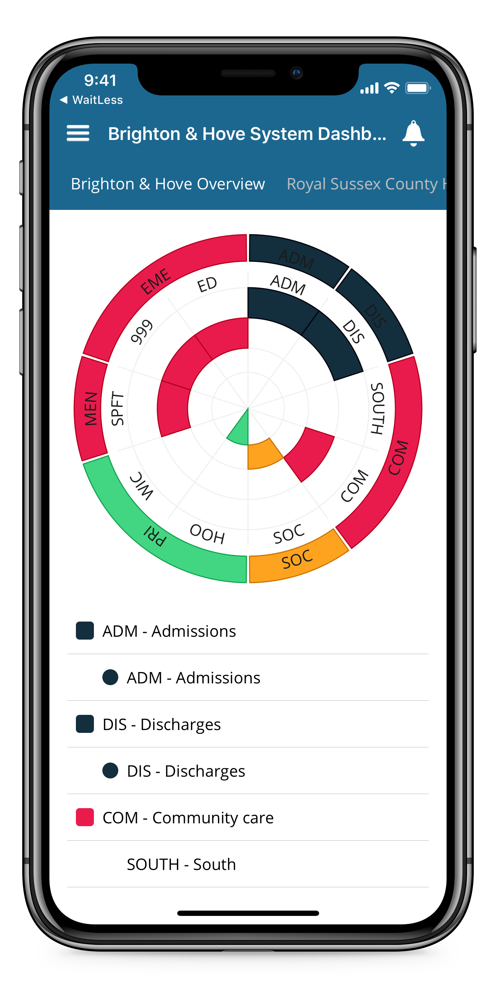
SHREWD Operations – Real-time data benefits
Response
Audit
Operational Data

Slide 8
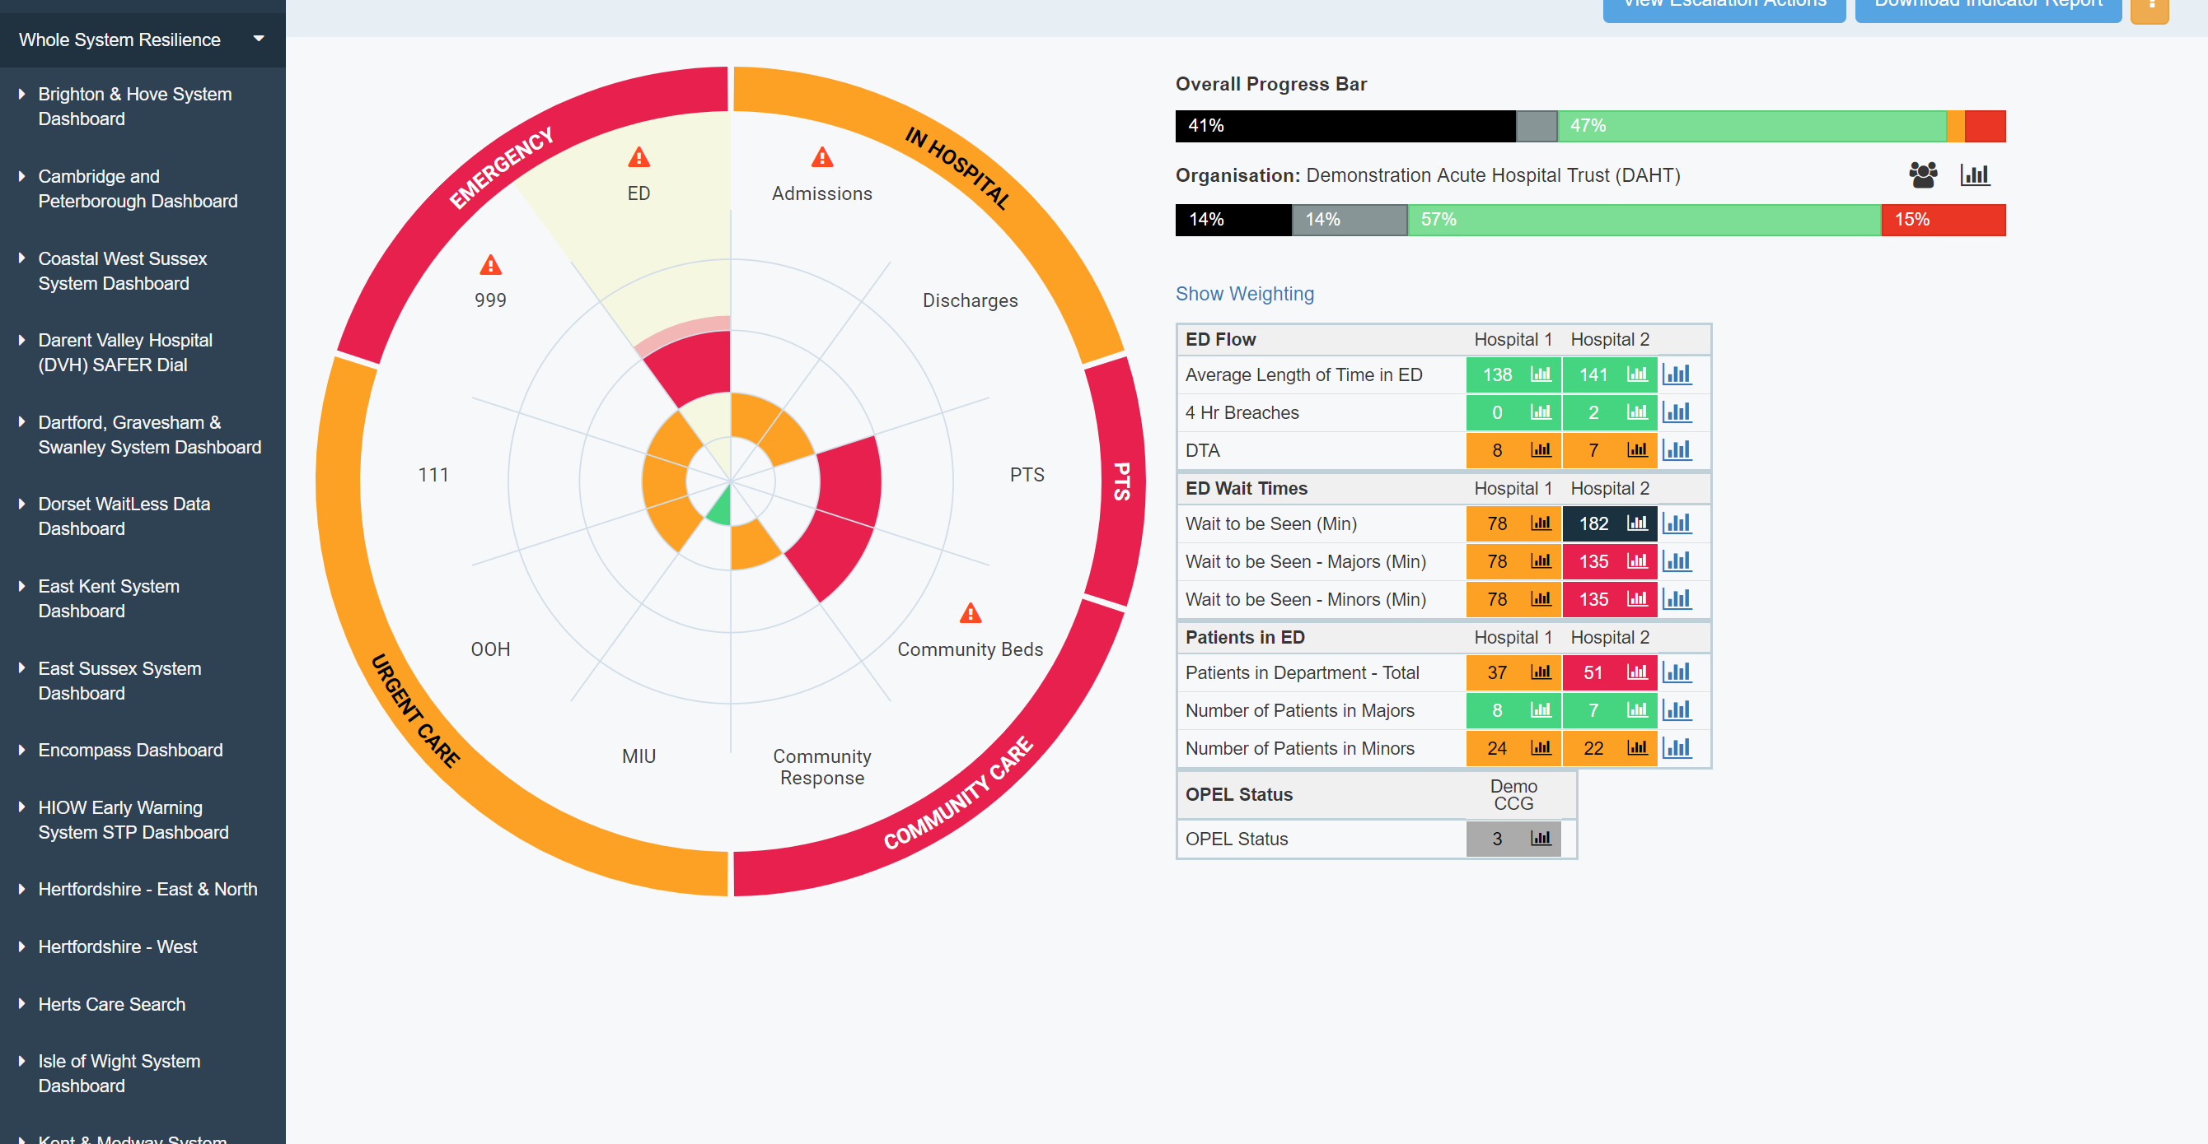
SHREWD Overview

Slide 9
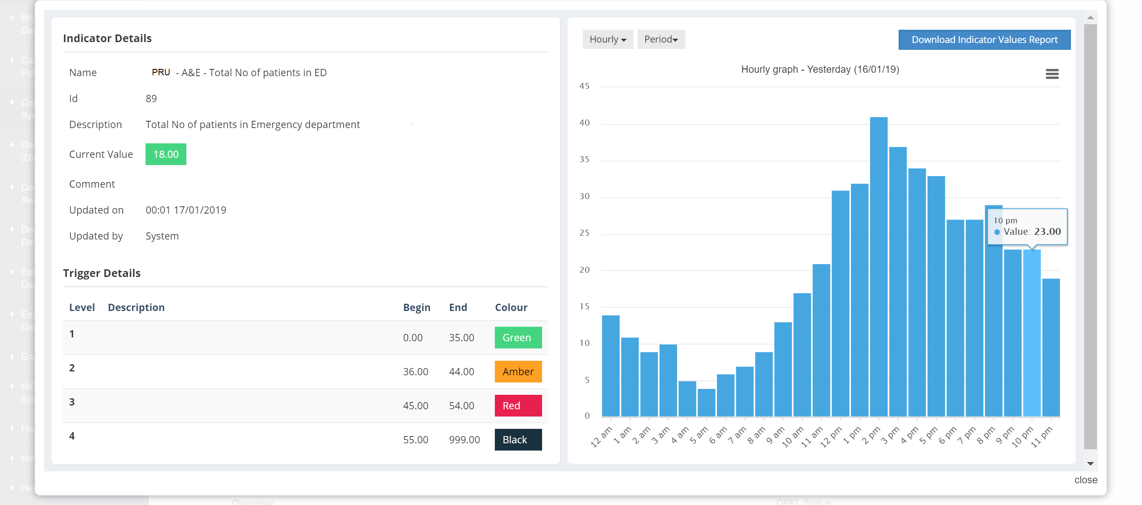
See Thresholds and trends: give context across the system

Slide 10
Use information as early warning

Slide 11
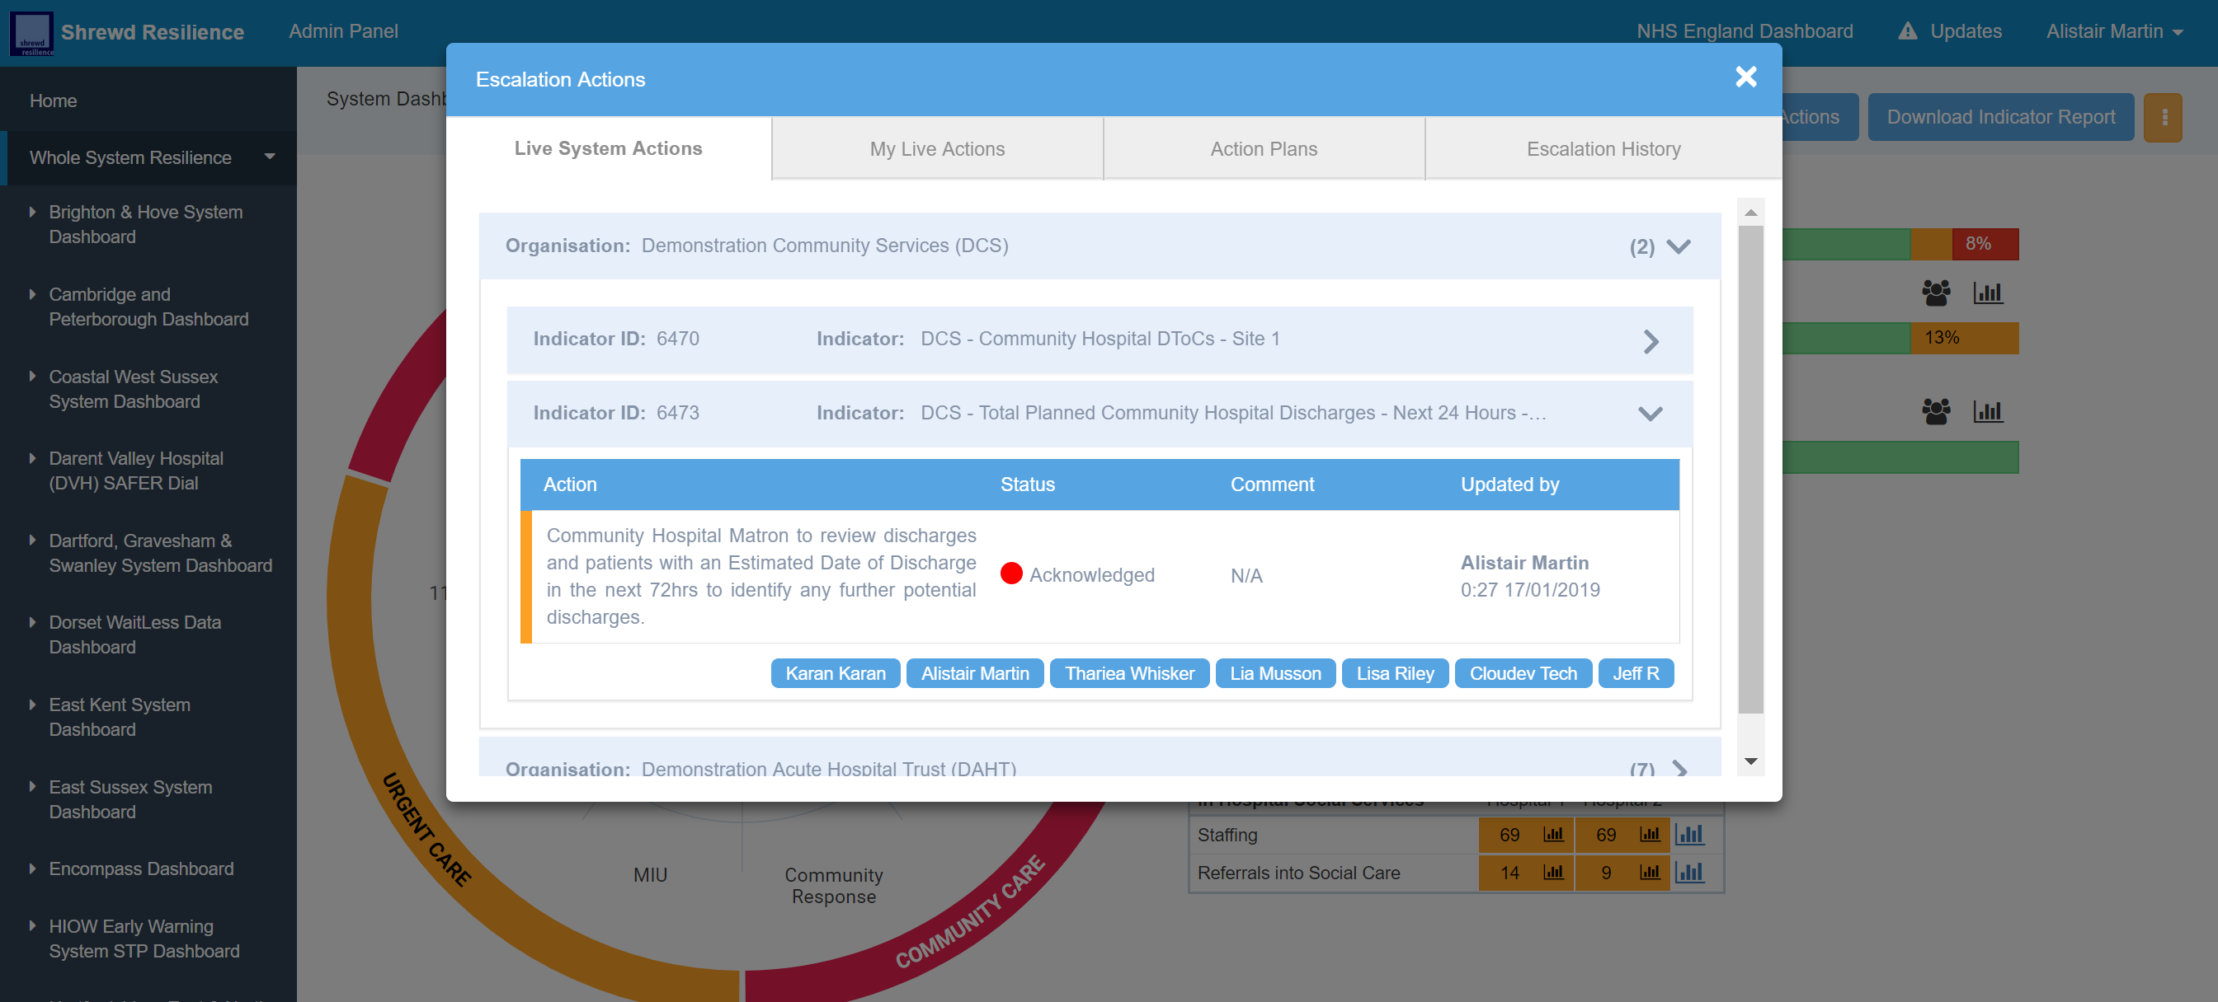
Link escalation plans to data!
Initiate whole system response in real-time!
Remove the need for teleconferences

Slide 12
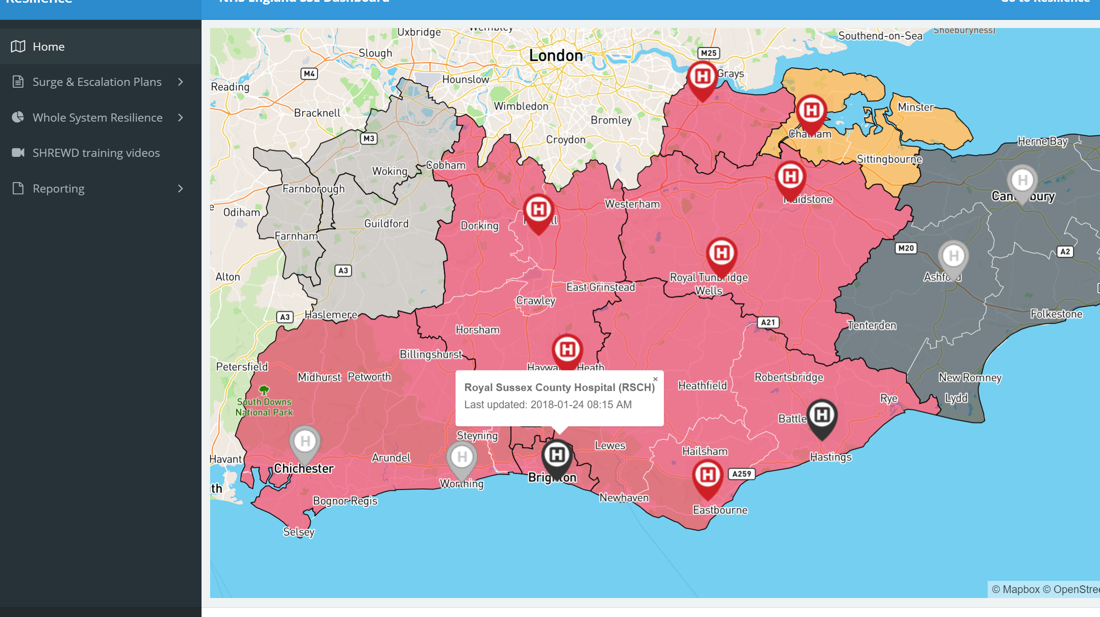
NHS Regional Reporting Tool
Automates OPEL Returns
Cuts administrative burden
Reduces need for regional teleconferences

Slide 13
Benefits
Integration of whole system data brings full visibility of capacity and demand
Cuts back on the need for multiple reports and whole system calls
Ability to create multiple views for providers, executive, operational and regional
Ability to take indicators that work for local health economies, using bespoke data (i.e. ‘Golden Patients’, stranded discharges etc)

Slide 14
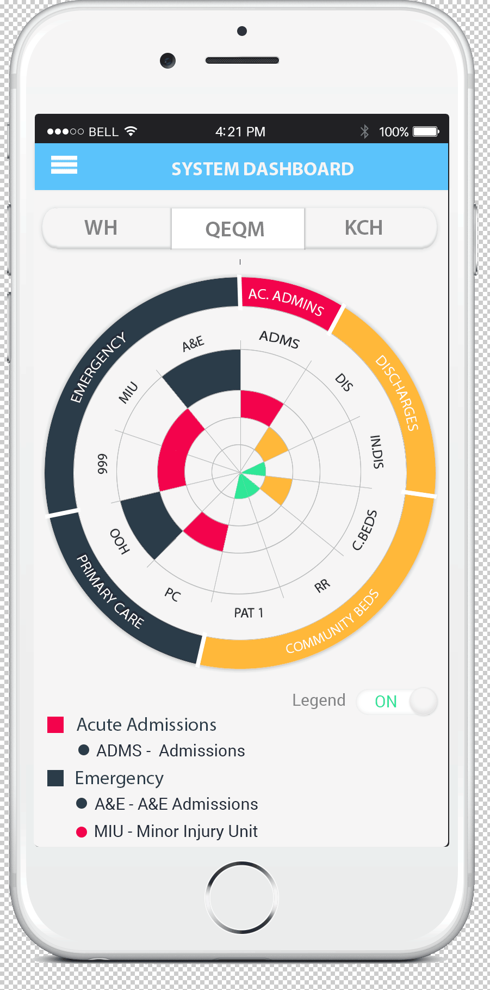
Alistair Martin
Chief Commercial Officer
Transforming Systems
Email: Alistair@transformingsystems.com
Tel: +44 (0)7887 716759
Questions?

Slide 15
Case Studies – Hospital Operations
John Ferguson, General Manager for Acute and Emergency Medicine, Medway Foundation Trust:
“Since the trust has had SHREWD, we can see where we sit in the wider picture for the first time. This has meant that I can see which levers to pull and they aren’t what we may previously have assumed they were. This in turn means that I am able to plan my escalation actions with confidence that we will be reaching for the right solutions. As my community based partners are using SHREWD, I have received offers of help I didn’t ask for because they can see that they are operating at OPEL 1 or 2 whilst the hospital trust is operating at OPEL 3 or 4. Once you have it you couldn’t be without it”

Slide 16
Case Studies – Local Authority
Lorretta Rogers, Coastal Operations Manager, West Sussex County Council
“As social care Operations manager in a health and social care system, where the local authority are the sole funder for a number of Discharge to Assess beds in the community, it is imperative for me to be able to keep track of bed usage and ensure that vacancies are being pro-actively managed.
SHREWD has enabled me to add escalation actions, which will automatically alert me if bed occupancy drops to a certain level – this then reminds me to take action in a timely manner, to reduce the vacancy level.
This supports flow in the system, ensures effective use of scarce resources and is financially efficient”

Slide 17
Case Studies – Local Authority
Jacqui West, Health Interface Manager (County Wide), Kent County Council:
“SHREWD Resilience has enabled me to supply real time data to council management and operational partners, which we weren’t previously able to do. Not only has this facilitated more meaningful day to day operational decision making both internally and with partners, it has enabled us to build an operational evidence base to inform management decisions related to service redesign. The SHREWD indicators are also identified in the System Resilience Plan. They are vital to the action plan which gives directives and action to staff at all levels in times of pressure.”

